Slide 1

BASAVESHWAR ENGINEERING College (AUTONOMOUS) BAGALKOt
DEPARTMENT OF ELECTRONICS AND COMMUNICATION
REPORT
OTP Generation using Python
Subject: Higher Programming Paradigm
Subject code : 21UEC308C
DIV: B
Presented By :
Name | USN | Roll no.
Rahul V K | 2BA21EC071 | 31
Shivaprakash Math | 2BA21EC094 | 43
Faculty I/C: Dr. M.C.Aralimarad

Slide 2
PHYTON PROJECT
topic name:OTP Generation

Slide 3
Introduction
Do you know how you get a unique OTP every time you go through the payment process in an online transaction? Each company has its ways of creating an OTP for generation, but most of the companies have their systems programmed to generate a n-digit random number. In this you get through the task of OTP generation using Python.

Slide 4
Steps to Create an OTP Generation System using Python OTP Generation is the process of verifying a user by sending a unique password so that the user can be verified before completing a registration or payment process. Most of the time, we get an OTP when we make an online payment, or when we forget our password, or when creating an account on any online platform. Thus, the sole purpose of an OTP is to verify the identity of a user by sending a unique password. We can easily create an application for the task of OTP generation using Python by following the steps mentioned below: First, create a n-digit random number Then store the number in a variable Then we need to write a program to send emails When sending email, we need to use OTP as a message Finally, we need to request two user inputs; first for the user’s email and then for the OTP that the user has received. So this is the complete process of creating an OTP verification application using Python. In the section below, I will take you through how to implement these steps using Python for the task of OTP verification.

Slide 5
One-time Passwords (OTP) is a password that is valid for only one login session or transaction in a computer or a digital device.Now a days OTP’s are used in almost every service like Internet Banking, online transactions, etc.They are generally combination of 4 or 6 numeric digits or a 6-digit alphanumeric. random() function can be used to generate random OTP which is predefined in random library. Let’s see how to generate OTP using Python . Used Function: random.random(): This function returns any random number between 0 to 1. math.floor(): It returns floor of any floating number to a integer value. Using the above function pick random index of string array which contains all the possible candidates of a particular digit of the OTP.

Slide 6
# import library import math, random # function to generate OTP def generateOTP() : # Declare a digits variable # which stores all digits digits = "0123456789" OTP = "" # length of password can be changed # by changing value in range for i in range(4) : OTP += digits[math.floor(random.random() * 10)] return OTP # Driver code if __name__ == "__main__" : print("OTP of 4 digits:", generateOTP())
OTP Verification Generation Source Code:

Slide 7
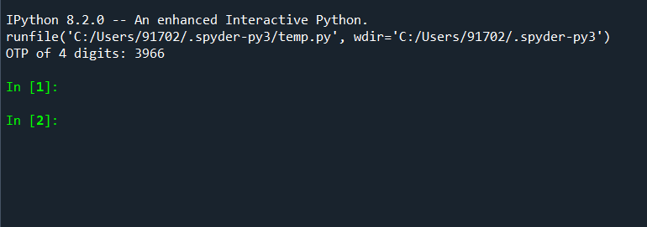
Output:

Slide 8
Summary So this is how you can create an application for your task of OTP verification. The next thing that you can do is use this logic to create the same application in a form of a user interface

Slide 9
THANK YOU

